Slide 1
Collections in Java
Core Java

Slide 2
Objectives
After Completing this session, you will be able to:
Define Collections
Describe usage of collections
Describe the benefits of collections
Understand the core collection Interfaces
Understand the implementations

Slide 3
What are Collections?
Collection of different elements in a single element is called Collections
Arrays: collection of similar type of elements are called array

Slide 4
Advantages of Collections
a)Collections size is dynamic, i.e, when you insert elements automatically memory will be increased
b)we can delete elements & insert elements as we want
c)there are some predefined methods for sorting, getting elements from collections

Slide 5
Disadvantages of Arrays
Arrays are static in size i.e once we declare we can not increase or decrease
Removing elements & adding elements in array is very difficult
Getting element, sorting are also difficult

Slide 6
Types of Collections
1d collections framework
Here we can store elements in the form of values
ex: {1,2,3,"abc","xyz",10.75}
2d collections framework
Here we can store elements in the form of <key,value> pair
Ex: {1:"abc",2:"xyz",3:"pqr"}
Here 1,2,3 are keys(objects)
abc, xyz, pqr are values(objects)
Note: what ever values we store in collections(1d,2d) all will be treated as objects, so collections stores objects only

Slide 7
1d Collections framework
As we know that 1d collections stores the data in the form of vlaues only, so in 1d there are some classes and interfaces

Slide 8
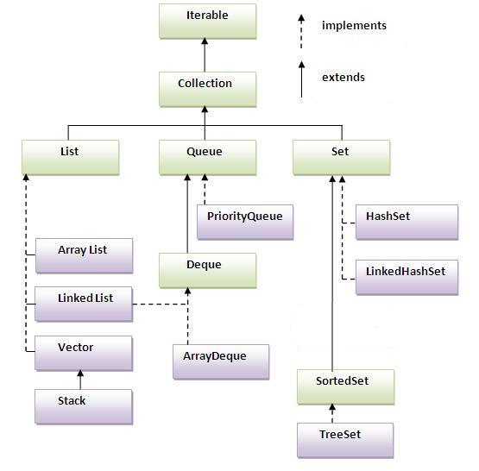
1d Collections framework

Slide 9
java.util.Collection
Collection is an super interface for all 1d collections
We can insert element at the end position
We can retrieve all elements only in forward direction
We can not retrieve single element
It allows duplicates

Slide 10
Methods in Collection
public boolean add(Object obj) : this method is used to insert element in collection if element is inserted then it returns true, else it returns false;
public boolean addAll(Collection obj): this method is used to add another collection object into current collection object
public boolean remove(Object) : this method is used to remove elements, if element is removed then it returns true, else it returns false
public boolean removeAll(): this method is used to removed all elements from collections
public void clear(): this method is used to remove all elements from collections
clear will be faster than removeAll

Slide 11
Methods in Collection
public int size(): this methods finds number of elements in Collection
public boolean contains(Object ) : it checks specific object exists in collection or not
public boolean containsAll(Collection obj): it checks specific objects are existed or not
public boolean isEmpty(): this method checks if Collection is empty or not
public Iterator iterator() : here Iterator is an interface which is used to retrieve elements one by one from collection
code:
Iterator ite = obj.iterator();
while(ite.hasNext()) {
System.out.println(ite.next());
}

Slide 12
Methods in Collection
public Object[] toArray:
Collection<String> obj = new ArrayList<>();
obj.add("10");
obj.add("20");
obj.add("30");
//finding size of Collection
System.out.println(obj.size());
obj.remove("20");
//now find size of obj
System.out.println(obj.size());
//retirve elements from Collection
Iterator<String> ite = obj.iterator();
while(ite.hasNext()){
String s = ite.next();
System.out.println(s);
}
//remove object 20

Slide 13
java.util.List
List is sub interface of collection
In List we can retrieve elements in forward & backword direction
we can insert element in any position
Elements will be displayed in sequential order
It allows duplicates
List is implemented in ArrayList,LinkedList,Vector

Slide 14
Methods in List
What ever methods are there in Collection all methods will be inherited into List, And List is having its own methods
public void add(int postion, Object val): this method is used to insert element in particluar postion
public Object get(int postion): we can retrive element from particular postion
public Object remove(int postion): we can remove element from particular postion
public Object set(int position,Object val): Replaces the element at the specified position in this list
public int indexOf(Object ): Returns the index of the first occurrence of the specified element in this list

Slide 15
Methods in List
vi. public ListIterator listIterator(): Returns a list iterator over the elements in this list (in proper sequence).
vii. ListIterator is an interface which is having following methods
a)public boolean hasNext()
b)public Object next()
c)public boolean hasPrevious()
d)public Object previous()
viii. public List retainAll(Collection) : Retains only the elements in this list that are contained in the specified collection

Slide 16
java.util.ArrayList, LinkedList & Set
java.util.ArrayList
ArrayList is a class which allocates contounious memory
java.util.LinkedList
LinkedList is a class which allocates memory node wise
java.util.Set
a)Set is a sub interface of Collection
b)it does not allow duplicates
Set is implemented in HashSet & LinkedHashSet
HashSet displays the data in random order where as LinkedHashSet displays the data in sequitails order

Slide 17
java.util.SortedSet
SortedSet is subinterface of set
It does not allow duplicates
It displays the data in sorting order
Sortedset is implemented in TreeSet

Slide 18
2d Collection Framework
2d collection framework stores data in the form of key, value pair
All keys are unique, values can be duplicates
Interface in 2d collection

Slide 19
Java.util.map
Map is an interface which allows to store key,value pair
Map interface is implemented in HashMap, LinkedHashMap
HashMap displays the data in ascending order of key, where as LinkedHashMap displays the data in inserted order
a)public boolean put(Object key,Object val): this method is used to insert element in Map
b)public int size(): this method is used to find number
c)public void clear(): this method removes all pairs from map
d)public boolean containsKey(Object key): it checks whether particular key exists in Map or not

Slide 20
Java.util.map
e)public boolean containsValue(Object value): it checks wheter particular value exists in Map or not
f)public boolean containsValue(Object val):it checks whether particular value exists in Map or not
g)public Object get(Object key): used to get value for the key from map object
h)public Set<Map.Entry<Object,Object>> entrySet: which is used to get all pair( key,value ) from map
Map.Entry is a class which is there in Map interface
Map.Entry holds one key, one value i.e one pair object

Slide 21
Java.util.map
Example:
Map<String,String> map = new HashMap<>();
map.put("1","abc");
map.put("2","xyz");
map.put("3","pqr");
Set<Map.Entry<String,String>> set = map.entrySet();
Iterator<Map.Entry<String,String>> ite =set.iterator();
while(ite.hasNext()){
Map.Entry<String,String> me = ite.next();
System.out.println(me.getKey()+" "+me.getValue());
}

Slide 22
Java.util.map
i) public Set<Object> keySet(): which retrieve all keys into Set object
Note : Map object is having unqiue keys(no duplicates)
j) public Collection<Object> values(): which returns all values(values can duplicates) from Map object
k) public boolean isEmpty(): it checks whether map have <key,value> or not
l) public void putAll(Map obj): it adds another map object to existing map object
m) public Object remove(Object key): it removes one pair which we want to remove

Slide 23

You have completed Collections in Java

